Slide 1

Planning Zoning

Slide 2
Planning Zone
Building Density (Συντελεστής Δόμησης)
Site Coverage (Συντελεστής Κάλυψης)
Floors (Όροφοί)
Height (‘Ύψος)

Slide 3
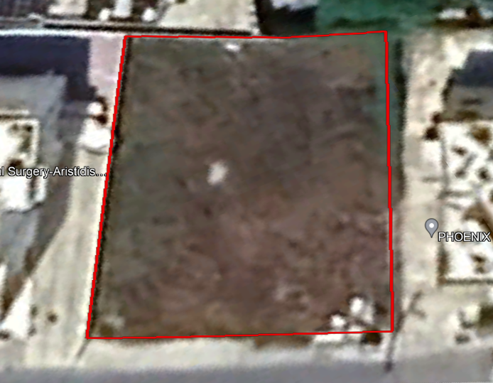
The Plot

Slide 4
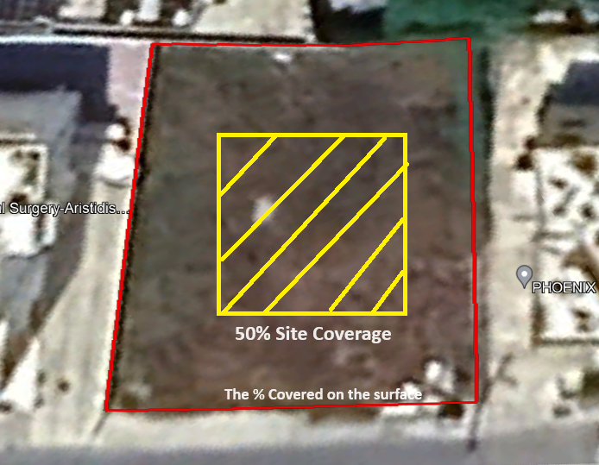
Site Coverage

Slide 5
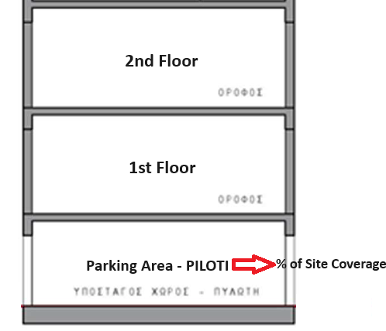
Site Coverage

Slide 6
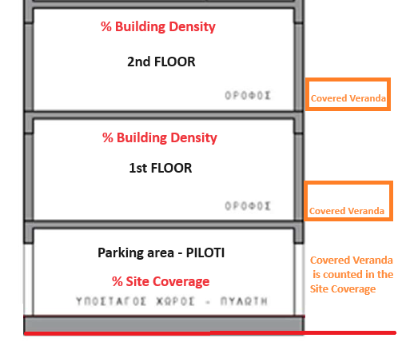
Site Coverage
The site coverage is basically what is covered on the land surface in a bird's eye view
The red line

Slide 7
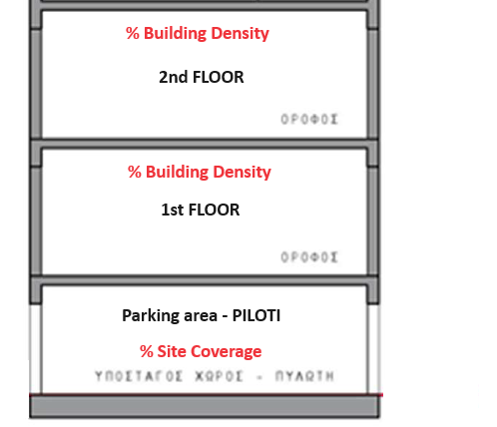
Building Density

Slide 8
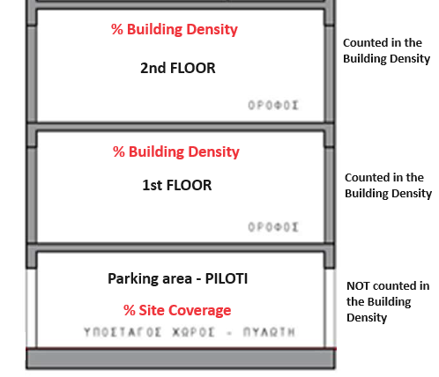
Building Density

Slide 9
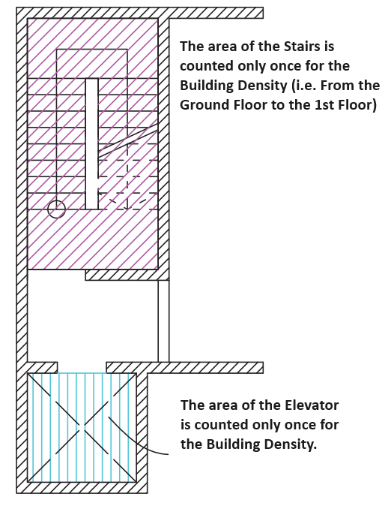
Building Density – How and what is counted

Slide 10
Building Density – How and what is counted
The covered verandas on each level must not exceed 25% of the (net) buildable area of that specific level in Local Plans / City’s Regional areas (Τοπικά Σχέδια) and 20% in the Rural Countryside Plan (Δήλωση Πολιτικής). Otherwise, the additional area is considered in the Building Density.
Corridors are counted in the Building Density
Piloti / Parking area is not counted in the Building Density
Lobby / Entrance area, up to a certain degree, is not counted in the Building Density
If the storage area is small, up to a certain degree, is not counted in the Building Density
Disclaimer: This knowledge is for illustration purposes only. Its intention is to provide an initial knowledge.

Slide 11
Development Example of a Plot

Slide 12
Development Example of a Plot
Plot Size: 530m2
Planning Zone: Κα3
Building Density: 1.4 = 140%
Site Coverage: 0.5 = 50%
Floors: up to 4
Height: up to 17 meters

Slide 13
Development Example of a Plot
530m2
Building Density: 140%
Site Coverage: 50%
Floors: 4
Height: 17 meters
530 x 1.40 = 742m2 (Building Density)
530 x 0.50 = 265m2 (Site Coverage)

Slide 14
Development Example of a Plot
530 x 1.40 = 742m2 (Building Density)
530 x 0.50 = 265m2 (Site Coverage)
Floors: 4
Height: 17 meters
What is the net buildable area?
We need to deduct the communal areas that are counted in the building density to determine the actual m2 for the apartments.
As a rule of thumb we need to deduct the total building density 742m2 by 10%, that is the approximate area that goes to the communal areas that are counted in the density.
So, 742m2 x 0.90 = 667m2 (net buildable area)

Slide 15
Development Example of a Plot
To apply the development example we do as follow:
742m2 (Building Density)
667m2 (net Building Density)
265m2 (Site Coverage)
4 (Floors)
17 meters (Height)
So, 667m2 / 4 (floors) = 166m2 on each floor
166m2 / 2 (for example 2 apartments) = 83m2 of net indoor area for each apartment
As a result you can have 8 x 2 bedroom apartments in this plot for example and each will be 83m2 of net indoor area.
How does the covered verandas calculated?
667/4 = 166m2 (net) buildable on each level
166m2 x 0.25 (25%) = 41m2 of total covered verandas on each level
41m2 covered verandas / 2 apartments on each = 20.5m2 of covered verandas for each apartment approximately.
Therefore, each apartment will be approximately 83m2 Net indoor area + 20m2 of Covered verandas – For Example!

